Slide 1
Basketball moves
By Marc Qin and Maya Qin

Slide 2
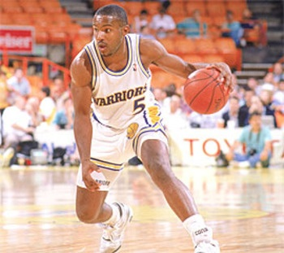
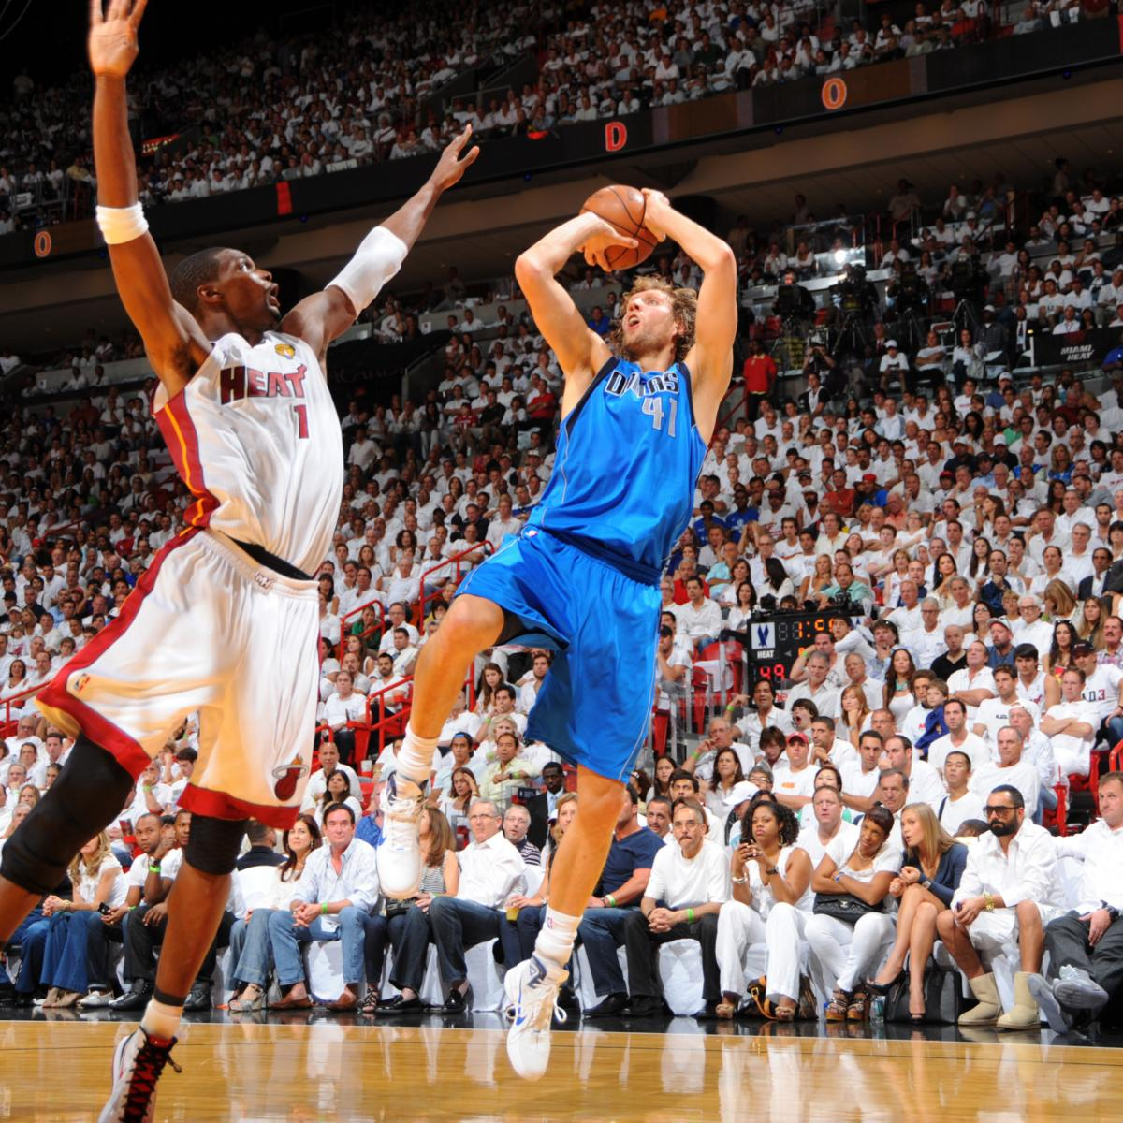
Introduction
Now, everyone knows something like the crossover or the between the legs. But what if we take it to the next level? Today I will be showing you some moves that you might not know. These are some moves that might be a combination of what you know. Or it might be different.

Slide 3
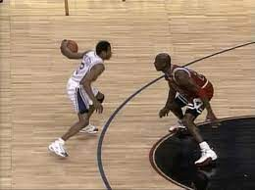
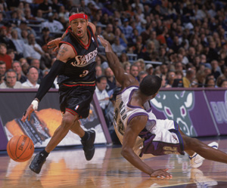
Killer crossover
Everyone knows the basic crossover, where all you do is switch the ball between one hand and another. But what if you make that wider and lower? That is how the killer crossover works. Even though it sounds simple, it is very complicated. But, if you do it well, you get a nasty reward. The ankle breaker. This move makes a player lose balance to one side and then you swiftly change hands and BOOM. There you have it. You had ankle broken your opponent. A famous NBA player who does this is Allen Iverson. A short but quick ankle breaker.

Slide 4
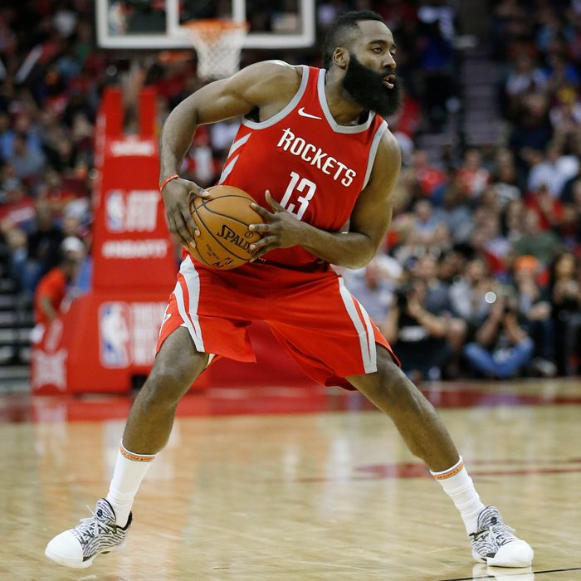
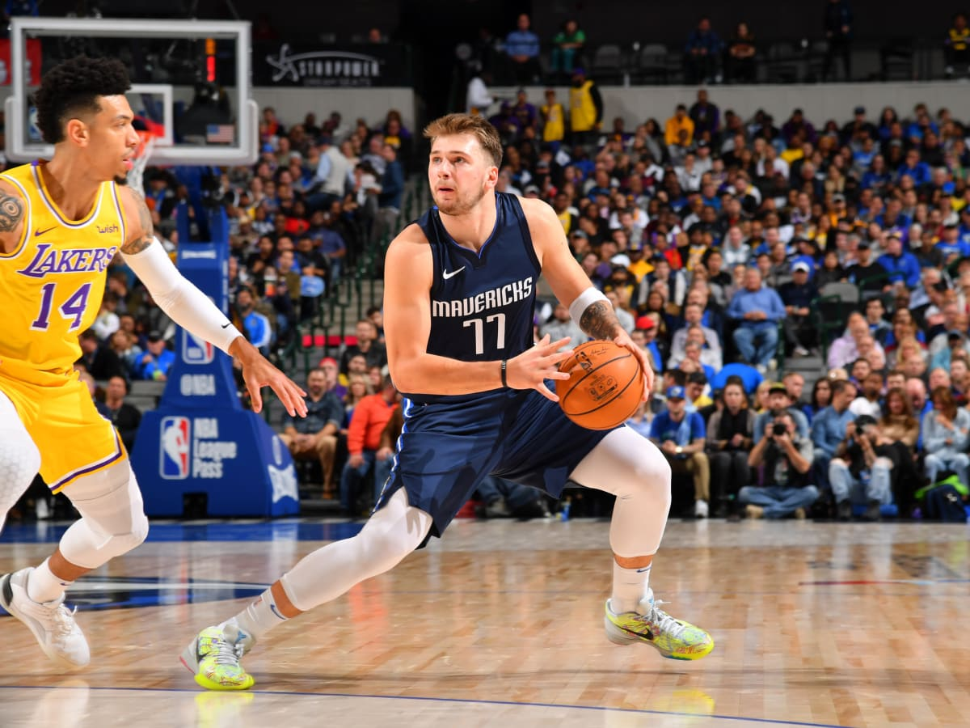
Gather step three
One of the ways to shoot a three. Using this method, you could create space with a slight push, a little bounce, step back, and then shoot. Right? No, first you have to pocket the ball while you take that little bounce. Otherwise, the referee without a doubt will call a travel. Famous NBA players who do this the most are James Harden and Luka Doncic.

Slide 5
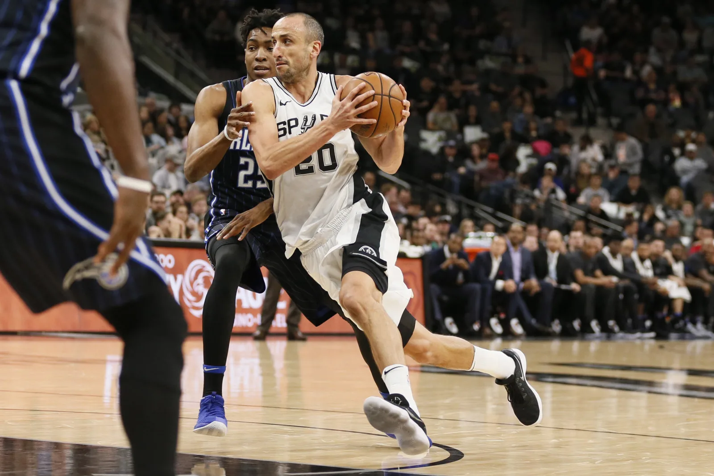
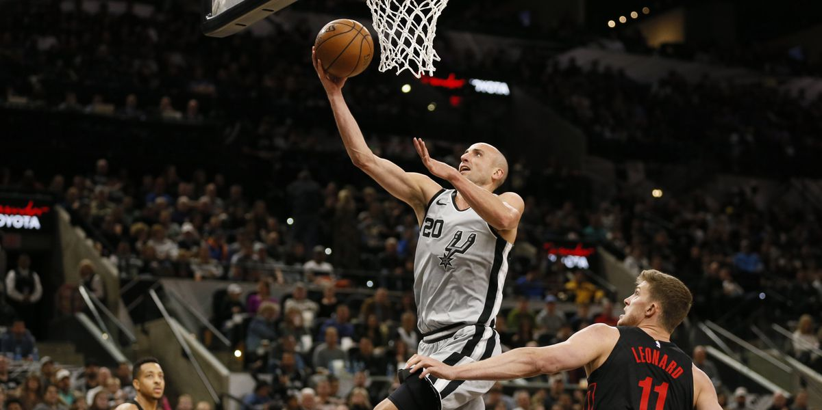
Euro-step
The euro step was a harder form of layup. Instead at charging straight at the hoop, the euro-step is where you step to the side and then back. This move was very effective and has the ability to throw off the timing of the defender to block the shot. It could also help the player avoid a charge. A notable NBA player who invented this was Manu Ginobili and he was from Argentina and that was how the layup got its name.

Slide 6
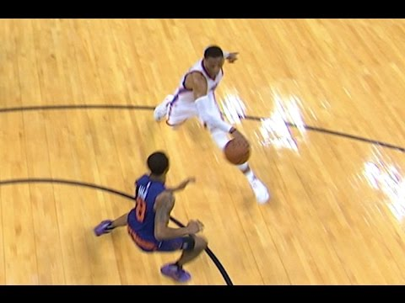
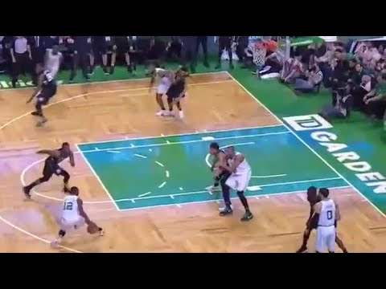
Shammgod
This is a extended version of the in-out where the player pushes the ball out with one hand then drags it back. This way the defender gets forced to one side or otherwise the player passes the player very easily. The name from the NBA player called God Shammgod and then named after his name since he invented it.

Slide 7
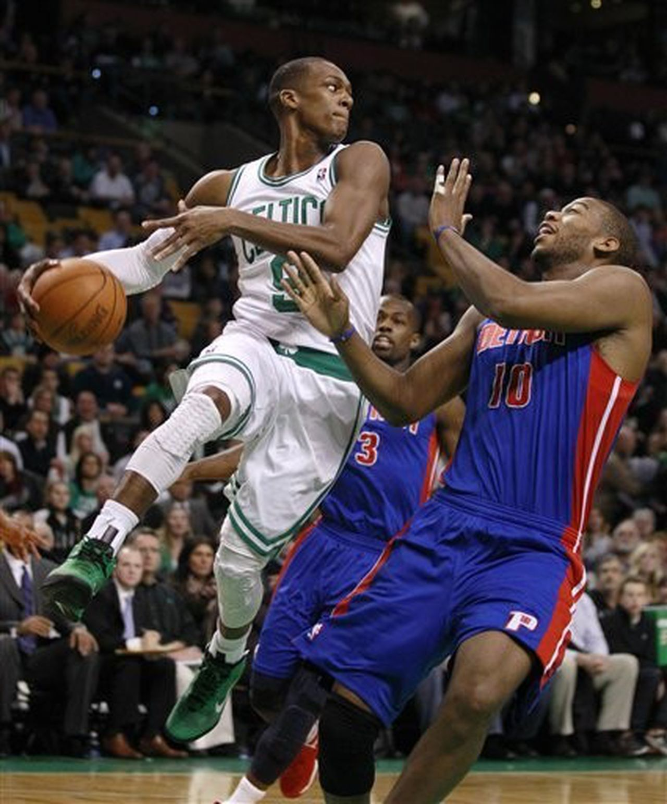
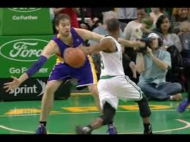
Fakeout
The fakeout is the layup but instead of just going straight to the hoop, there is a hesitation and there is a fake pass before the layup. This move was first used by the NBA player Rajon Rondo and is now used all over the world by everyone.

Slide 8
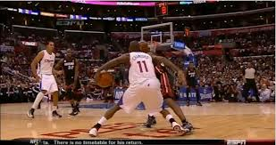
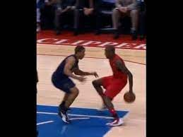
Shake ‘n Bake
The shake ‘n bake is a really effective way of getting past the defender. This move uses the behind the back and then switching the ball back to the other hand. The creator of this move is Jamal Crawford.

Slide 9
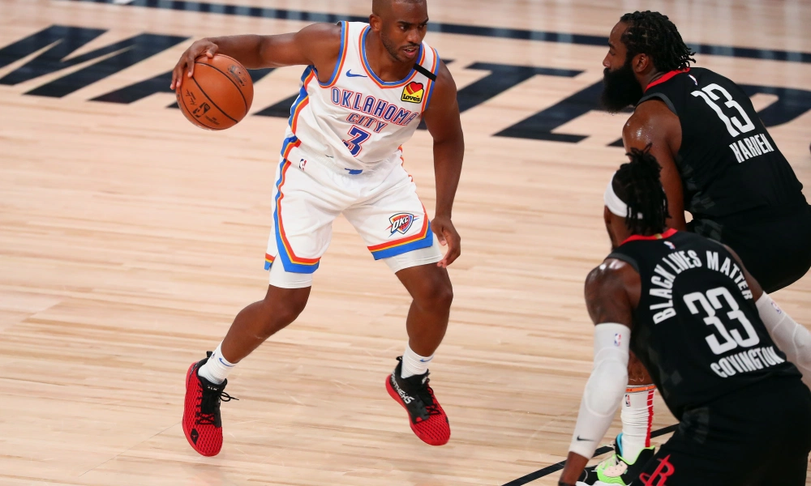
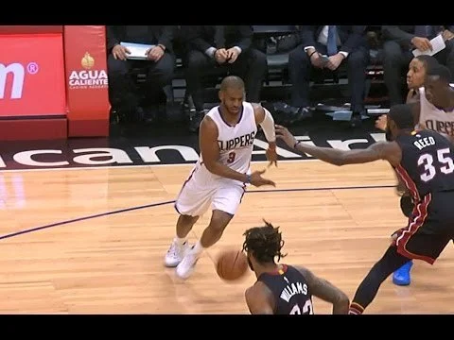
Yo-yo Dribble
On the move, the player pushes the ball in front of them with one hand — almost like they're pretending to pass — but they put tremendous back spin on the ball so it bounces back towards them as they drive. The NBA player who does this is Chris Paul.

Slide 10
Thanks for
Watching

